Slide 1
A Plan for a Safe Club Opening during the COVID-19 Pandemic
Board of Governors
September 8, 2020

Slide 2
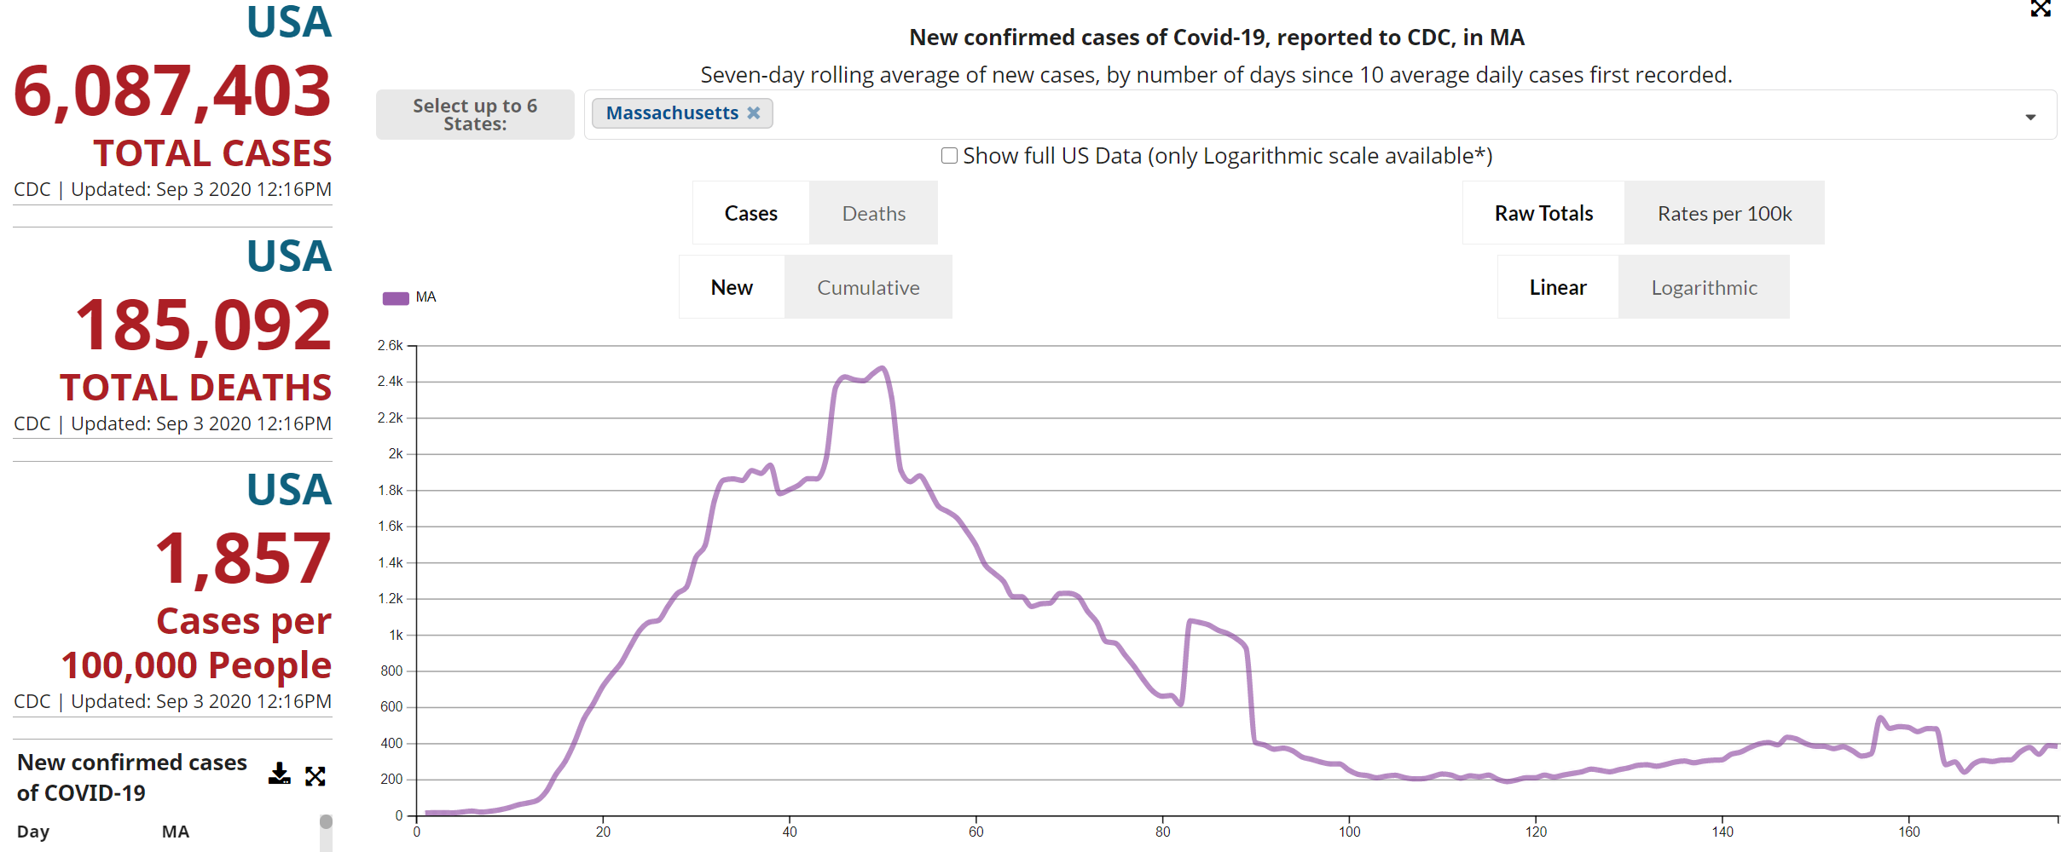
COVID-19 Pandemic in Massachusetts
187
July 5, 2020
393
September 3, 2020
https://covid.cdc.gov/covid-data-tracker/#compare-trends

Slide 3
COVID-19 Pandemic in Massachusetts
https://covid.cdc.gov/covid-data-tracker/#compare-trends

Slide 4
CDC Recommendations for Prevention
Handwashing/Disinfecting
Often and thoroughly
Wear a Mask Around Others
Cover your mouth and nose when sneezing or coughing
Stay Home if You Feel Sick
Social Distancing
Stay at least 6 feet away from others

Slide 5
Overview of Plan
Physical changes to the club
Staff-based measures
Member-based measures
Programmatic changes

Slide 6
Physical Changes to the Club
Install a UVC air cleansing system
Install door in garage door for member exits
Move coat rack to court floor area
Close off second floor
Improve air circulation in bathroom at court level
Install touchless fixtures in all bathrooms
Install plexiglass screen around front desk
Install easily-visible signs for directions, spread prevention, etc.
Hand-cleansing stations on court and throughout the club

Slide 7
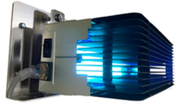
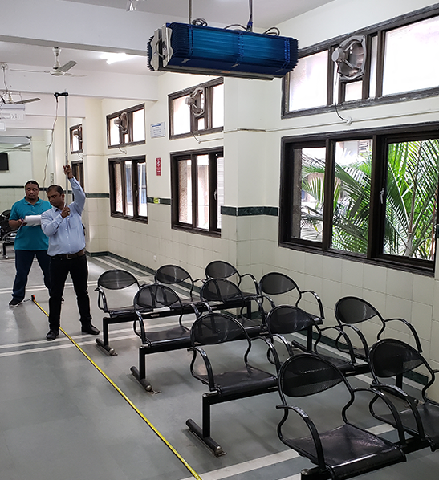
UVC Air Cleansing System

Slide 8
Staff-Based Measures
Staff must take a COVID-19 test during the last week of September and provide proof they tested negative.
Each day they report for work employees must make a health attestation, that states they do not have any symptoms nor have come in contact with someone who has the virus.
In addition to their normal jobs, the following will be required of employees while at work:
Wear a face covering at all times except when eating or drinking
Maintain 6’ separation
Wash hands after contact outside front desk
Take temperature of everyone entering the building
Disinfect common-use surfaces hourly
Employees who contract the virus are to leave the club/stay at home and will receive full pay while recovering (they must present doctor’s authorization in order to return to work).
They must notify the club manager who will notify members.

Slide 9
Member-Based Measures
Before coming to play at the club:
Members who have tested positive for COVID-19, are not allowed in the club until 2 weeks after full recovery (or have obtained two negative COVID-19 tests if desiring to return earlier).
They must notify the club manager who will notify members.
Reserve a court (no walk-on play).
Courts can be reserved as usual.
Bring your own water (water will not be available on court).
Plan to arrive no more than 5 minutes before your court time.

Slide 10
Member-Based Measures
Upon arriving at the Club:
Wear a face covering while not actively playing.
Complete a health attestation upon arrival.
Allow staff to take your temperature.
Wait for your court only in the club room.
There will be no food or beverages offered.
Tennis balls will be available for sale.

Slide 11
Member-Based Measures
Court Protocol:
The schedule of court times will be adjusted to allow for :15 idle time between reservations.
To give the air time to circulate and to avoid people crossing paths
Coat racks will be located on the court level.
Members to enter the court area at the appropriate time by using the south stairway (which will be labeled).
Members must leave their court at the designated time to avoid crowding as players change.
Exit the club via the north stairway, through the pro shop and out the garage door.

Slide 12
Programmatic Changes
Guests will not be allowed to start off the season.
DBH teams will be able to practice and conduct scrimmages between themselves but competing in matches/scrimmages/practices with other clubs will not be allowed.
Social events, including parties and Round Robins, will not be held.
A decision about tournament season will be made based on the success of the opening.

Slide 13
An Expectation of Citizenship
The success of the Club opening and its ability to remain open will depend on the combined efforts of the staff and members.
There is an expectation that the staff and members will adhere to these safety rules for the protection of our tennis community.
The staff is empowered to enforce these safety rules and backed by the Board.
If a rules violation is observed, the staff will ask the member to correct the violation.
Failure to do so, repeat offenses, and/or mistreatment of the staff or other members will be reported to the Board and subject to suspension of tennis privileges.

Slide 14
Closing Thoughts and Discussion
As we have learned, trends in the pandemic can change quickly, and we will have to adapt accordingly.
Our collective goals are to open safely, protect our members and staff, and be able to play tennis all season.
Most outbreaks have been due to lapses in judgement and human error rather than systems failure.
We have a narrow window through which to safely open the Club, and we all must do our part.

